Slide 1
Mehran S. Fallah
September 27, 2020
Game Theory
Session II
Games in Strategic Form (1)

Slide 2
Static Games of Complete Information
A Discourse on Inequality (Jean-Jacques Rosseau)
  “A group of hunters set out to take a stag. They are fully aware that they would all have to remain faithfully in their posts in order to be succeed; but if a hare happens to pass near one of them, there can be no doubt that he pursued it without qualm, and that once he had caught his prey, he cared very little whether or not he had made his companions miss theirs.”
Assumptions
  Two hunters
  They must decide simultaneously whether to hunt for stag or for hare
  If both hunt for stag, they will catch one stag and share it equally. If both hunt for hare, they each will catch one hare. If one hunts for hare while the other tries to take a stag, the former will catch a hare and the latter will catch nothing
  Each hunter prefers half a stag to one hare
A Game Model
  Players: the two hunters
  Players’ strategies (actions): Stag, Hare
  Payoffs: A stag is worth 4 and a hare is worth 1. When both players hunt stag, each has a payoff of 2. A player who hunts hare has payoff 1, and a player who hunts stag by himself has payoff 0.
Stag
Hare
Stag
2 , 2
0 , 1
Hare
1 , 0
1 , 1

Slide 3
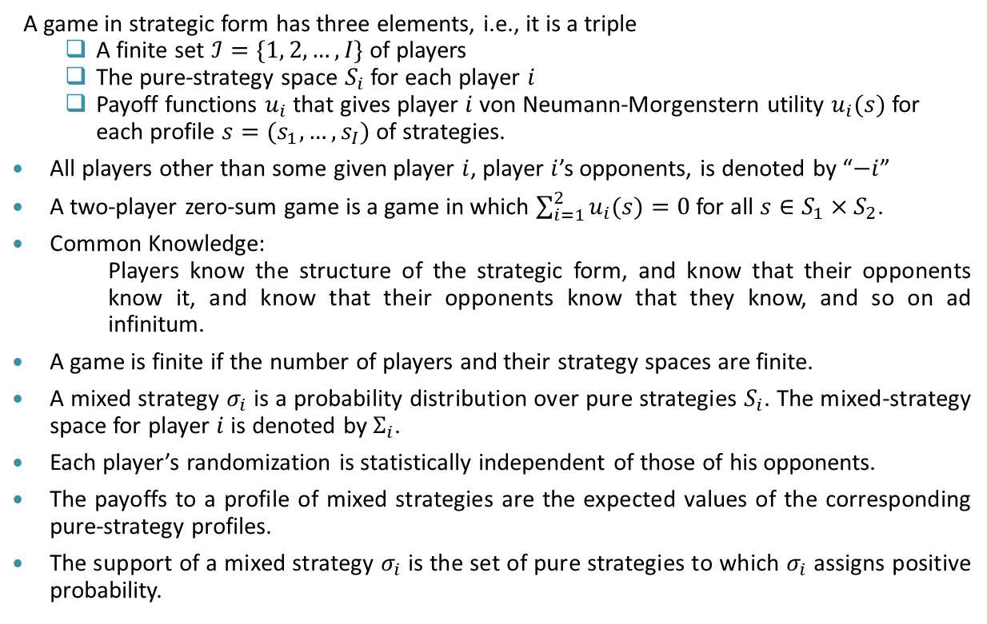
Strategic-Form Games
A game in strategic form has three elements, i.e., it is a triple
  A finite set $ℐ=\{1, 2, …, I\}$ of players
  The pure-strategy space $S_{i}$ for each player $i$
  Payoff functions $u_{i}$ that gives player $i$ von Neumann-Morgenstern utility $u_{i}(s)$ for each profile $s=(s_{1},…,s_{I})$ of strategies.
All players other than some given player $i$, player $i$’s opponents, is denoted by “$−i$”
A two-player zero-sum game is a game in which $\sum_{i=1}^{2}{u_{i}(s)}=0$ for all $s∈S_{1}×S_{2}$.
Common Knowledge:
      Players know the structure of the strategic form, and know that their opponents know it, and know that their opponents know that they know, and so on ad infinitum.
A game is finite if the number of players and their strategy spaces are finite.
A mixed strategy $σ_{i}$ is a probability distribution over pure strategies $S_{i}$. The mixed-strategy space for player $i$ is denoted by $Σ_{i}$.
Each player’s randomization is statistically independent of those of his opponents.
The payoffs to a profile of mixed strategies are the expected values of the corresponding pure-strategy profiles.
The support of a mixed strategy $σ_{i}$ is the set of pure strategies to which $σ_{i}$ assigns positive probability.

Slide 4
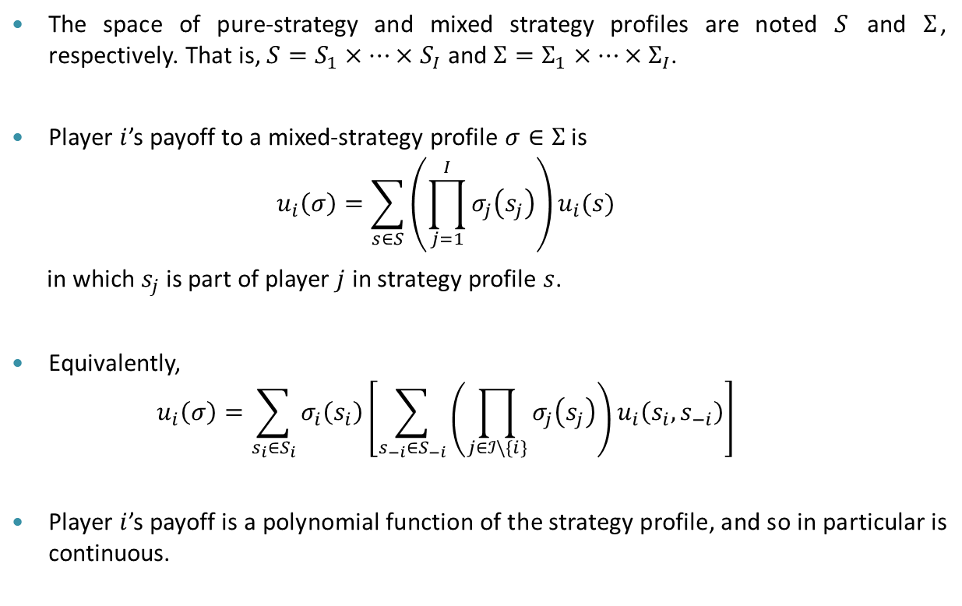
Strategic-Form Games
The space of pure-strategy and mixed strategy profiles are noted $S$ and $Σ$, respectively. That is, $S=S_{1}×…×S_{I}$ and ${Σ=Σ}_{1}×…×Σ_{I}$.
Player $i$’s payoff to a mixed-strategy profile $σ∈Σ$ is
    $$u_{i}\left(σ\right)=\sum_{s∈S}{\left(\prod_{j=1}^{I}{σ_{j}\left(s_{j}\right)}\right)u_{i}(s)}$$
  in which $s_{j}$ is part of player $j$ in strategy profile $s$.
Equivalently,
    $$u_{i}\left(σ\right)=\sum_{s_{i}∈S_{i}}{σ_{i}\left(s_{i}\right)\left[\sum_{s_{−i}∈S_{−i}}{\left(\prod_{j∈ℐ\backslash \{i\}}{σ_{j}\left(s_{j}\right)}\right)}u_{i}\left(s_{i},s_{−i}\right)\right]}$$
Player $i$’s payoff is a polynomial function of the strategy profile, and so in particular is continuous.

Slide 5



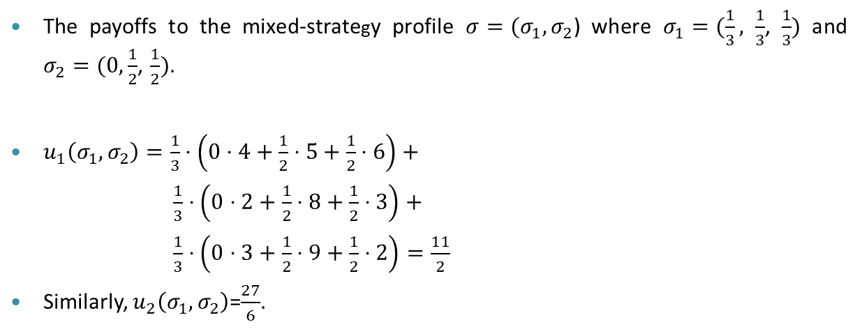



An Example
$$0$$
$$\frac{1}{2}$$
$$\frac{1}{2}$$
L
M
R
$$\frac{1}{3}$$
U
4 , 3
5 , 1
6 , 2
$$\frac{1}{3}$$
M
2 , 1
8 , 4
3 , 6
$$\frac{1}{3}$$
D
3 , 0
9 , 6
2 , 8
The payoffs to the mixed-strategy profile $σ=(σ_{1},σ_{2}$) where $σ_{1}=(\frac{1}{3}, \frac{1}{3}$, $\frac{1}{3})$ and $σ_{2}=(0,\frac{1}{2}$, $\frac{1}{2})$.
$u_{1}\left(σ_{1},σ_{2}\right)=\frac{1}{3}⋅\left(0⋅4+\frac{1}{2}⋅5+\frac{1}{2}⋅6\right)+$
$\frac{1}{3}⋅\left(0⋅2+\frac{1}{2}⋅8+\frac{1}{2}⋅3\right)+$
$\frac{1}{3}⋅\left(0⋅3+\frac{1}{2}⋅9+\frac{1}{2}⋅2\right)=\frac{11}{2}$
Similarly, $u_{2}\left(σ_{1},σ_{2}\right)$=$\frac{27}{6}$.

Slide 6
Dominated Strategies
L
M
R
U
4 , 3
5 , 1
6 , 2
M
2 , 1
8 , 4
3 , 6
D
3 , 0
9 , 6
2 , 8
No matter how player 1 plays, R gives player 2 a strictly higher payoff than M does. Indeed, M is strictly dominated.
If player 1 knows that player 2 will not play M, then U is a better choice than M or D.
Finally, if player 2 knows that player 1 knows that player 2 will not play M, then player 2 knows that player 1 will play U, and so player 2 should play L.
This process of elimination is called iterated deletion of strictly dominated strategies, or iterated strict dominance.

Slide 7
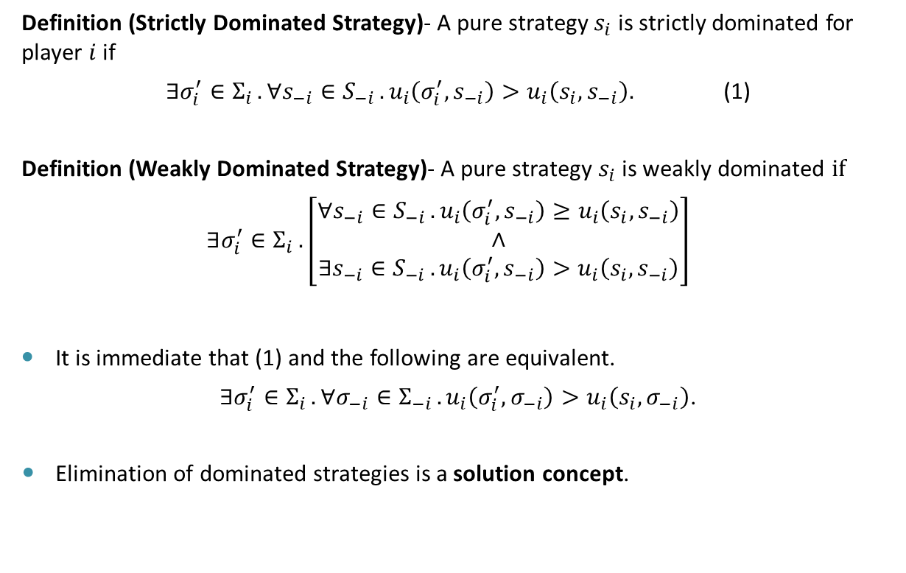
Dominated Strategies
Definition (Strictly Dominated Strategy)- A pure strategy $s_{i}$ is strictly dominated for player $i$ if
$∃σ_{i}^{′}∈Σ_{i }. ∀s_{−i}∈S_{−i }. u_{i}\left(σ_{i}^{′},s_{−i}\right)>u_{i}\left(s_{i},s_{−i}\right).$ (1)
Definition (Weakly Dominated Strategy)- A pure strategy $s_{i}$ is weakly dominated $if$
$$∃σ_{i}^{′}∈Σ_{i }.\left[\begin{matrix}∀s_{−i}∈S_{−i }. u_{i}\left(σ_{i}^{′},s_{−i}\right)≥u_{i}\left(s_{i},s_{−i}\right) \\ ∧ \\ ∃s_{−i}∈S_{−i }. u_{i}\left(σ_{i}^{′},s_{−i}\right)>u_{i}\left(s_{i},s_{−i}\right)\end{matrix}\right]$$
It is immediate that (1) and the following are equivalent.
$∃σ_{i}^{′}∈Σ_{i }. ∀σ_{−i}∈Σ_{−i }. u_{i}\left(σ_{i}^{′},σ_{−i}\right)>u_{i}\left(s_{i},σ_{−i}\right)$.
Elimination of dominated strategies is a solution concept.

Slide 8
Example (Dominated Strategies)
Prisoner’s Dilemma
Two people are arrested for a crime. The police lack sufficient evidence to convict either suspect and consequently need them to give testimony against each other. The police put each suspect in a different cell to prevent the two suspects from communicating with each other. The police tell each suspect that if he testifies against (doesn’t cooperate with) the other, he will be released and will receive a reward for testifying, provided the other suspect does not testify against him. If neither suspect testifies, both will be released on account of insufficient evidence, and no rewards will be paid. If one testifies, the other will go to prison; if both testify, both will go to prison, but they still collect rewards for testifying.
C
D
C
1 , 1
-1 , 2
D
2 , -1
0 , 0

Slide 9
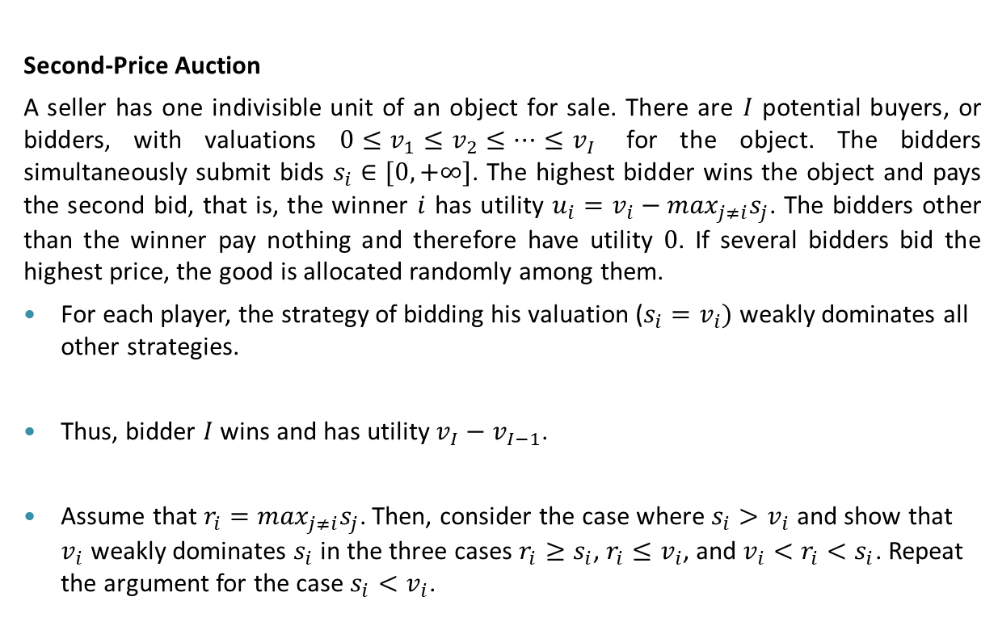
Example (Dominated Strategies)
Second-Price Auction
A seller has one indivisible unit of an object for sale. There are $I$ potential buyers, or bidders, with valuations $0≤v_{1}≤v_{2}≤…≤v_{I}$ for the object. The bidders simultaneously submit bids $s_{i}∈[0,+∞]$. The highest bidder wins the object and pays the second bid, that is, the winner $i$ has utility $u_{i}=v_{i}−\max_{j≠i}s_{j}$. The bidders other than the winner pay nothing and therefore have utility $0$. If several bidders bid the highest price, the good is allocated randomly among them.
For each player, the strategy of bidding his valuation ($s_{i}=v_{i})$weakly dominates all other strategies.
Thus, bidder $I$ wins and has utility $v_{I}−v_{I−1}$.
Assume that $r_{i}=\max_{j≠i}s_{j}$. Then, consider the case where $s_{i}>v_{i}$ and show that $v_{i}$ weakly dominates $s_{i}$ in the three cases $r_{i}≥s_{i}$, $r_{i}≤v_{i}$, and $v_{i}<r_{i}<s_{i}$. Repeat the argument for the case $s_{i}<v_{i}$.

Slide 10
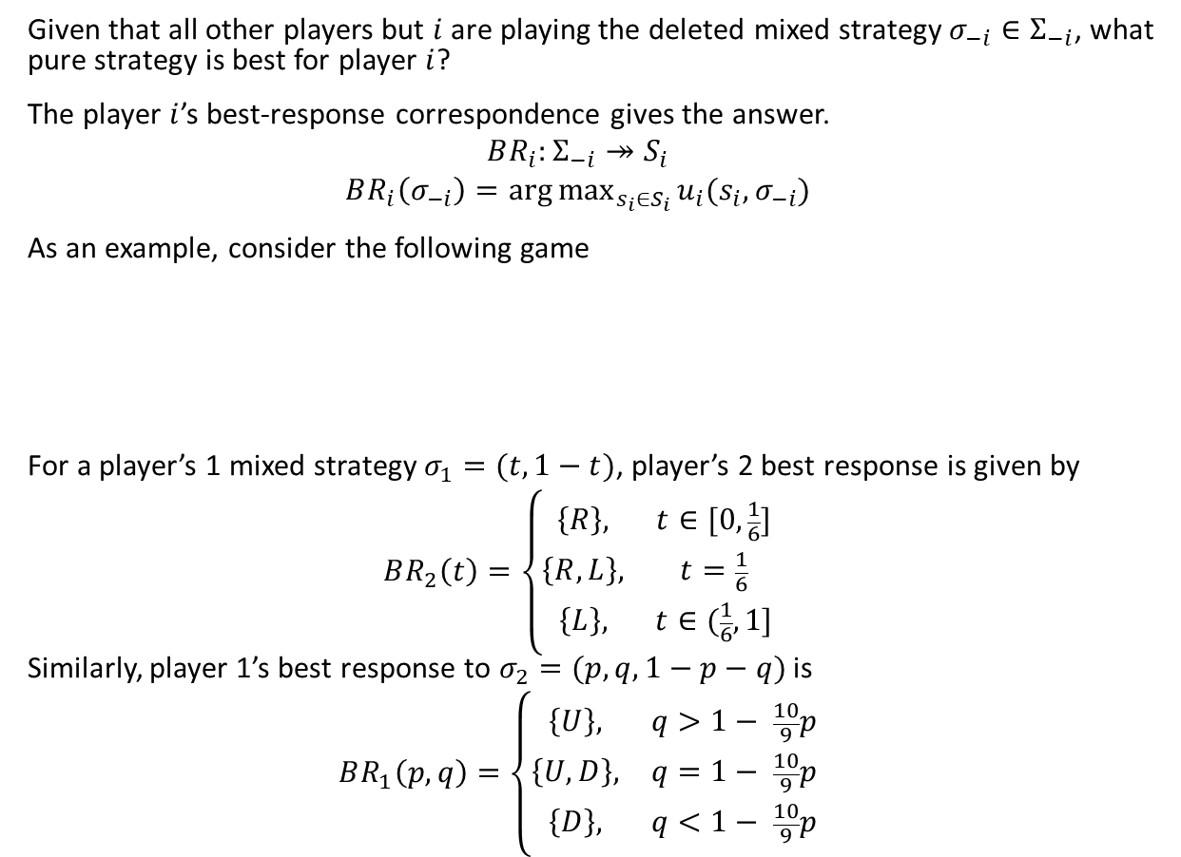
Best-Response Correspondence
Given that all other players but $i$ are playing the deleted mixed strategy $σ_{−i}∈Σ_{−i}$, what pure strategy is best for player $i$?
The player $i$’s best-response correspondence gives the answer.
$$BR_{i}:Σ_{−i}↠S_{i}$$
$$BR_{i}\left(σ_{−i}\right)=\arg{\max_{s_{i}∈S_{i}}}u_{i}(s_{i},σ_{−i})$$
As an example, consider the following game
For a player’s 1 mixed strategy $σ_{1}=(t,1−t)$, player’s 2 best response is given by
$$BR_{2}\left(t\right)=\left\{\begin{matrix}\left\{R\right\}, & t∈[0, \frac{1}{6}] \\ \left\{R,L\right\}, & t=\frac{1}{6} \\ \left\{L\right\}, & t∈(\frac{1}{6},1]\end{matrix}\right.$$
Similarly, player 1’s best response to $σ_{2}=(p,q,1−p−q)$ is
$$BR_{1}\left(p,q\right)=\left\{\begin{matrix}\left\{U\right\}, & q>1− \frac{10}{9}p \\ \left\{U,D\right\}, & q=1− \frac{10}{9}p \\ \left\{D\right\}, & q<1− \frac{10}{9}p\end{matrix}\right.$$
L
M
R
U
2 , 8
7 , 7
0 , 3
D
1 , 5
7 , 4
9 , 6

Slide 11
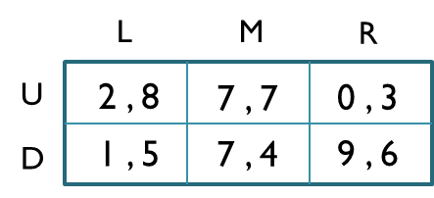
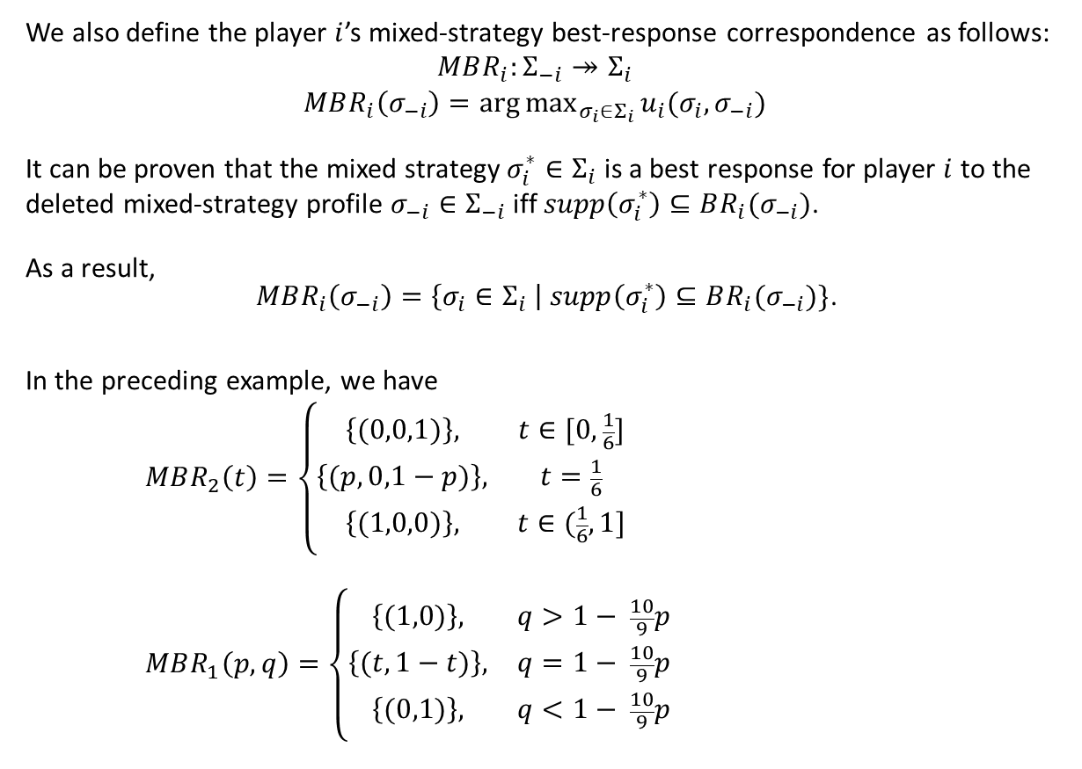
Best-Response Correspondence
We also define the player $i$’s mixed-strategy best-response correspondence as follows:
$$MBR_{i}:Σ_{−i}↠Σ_{i}$$
$$MBR_{i}\left(σ_{−i}\right)=\arg{\max_{σ_{i}∈Σ_{i}}}u_{i}(σ_{i},σ_{−i})$$
It can be proven that the mixed strategy $σ_{i}^{∗}∈Σ_{i}$ is a best response for player $i$ to the deleted mixed-strategy profile $σ_{−i}∈Σ_{−i}$ iff $supp\left(σ_{i}^{∗}\right)⊆BR_{i}(σ_{−i})$.
As a result,
$MBR_{i}\left(σ_{−i}\right)=\left\{σ_{i}∈Σ_{i} \right| supp\left(σ_{i}^{∗}\right)⊆BR_{i}(σ_{−i})\}$.
In the preceding example, we have
$$MBR_{2}\left(t\right)=\left\{\begin{matrix}\left\{(0,0,1)\right\}, & t∈[0, \frac{1}{6}] \\ \left\{(p,0,1−p)\right\}, & t=\frac{1}{6} \\ \left\{(1,0,0)\right\}, & t∈(\frac{1}{6},1]\end{matrix}\right.$$
$$MBR_{1}\left(p,q\right)=\left\{\begin{matrix}\left\{(1,0)\right\}, & q>1− \frac{10}{9}p \\ \left\{(t,1−t)\right\}, & q=1− \frac{10}{9}p \\ \left\{(0,1)\right\}, & q<1− \frac{10}{9}p\end{matrix}\right.$$

Slide 12



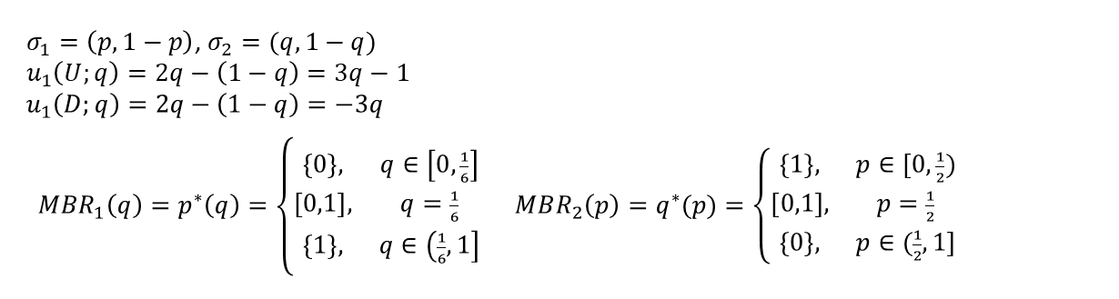





Mixed-Strategy Best-Response Correspondence
L
R
$$q$$
$$q^{∗}(p)$$
$$1$$
$$p^{∗}\left(q\right)$$
U
2 , -1
-1 , 2
D
-3 , 2
0 , -1
$$\frac{1}{6}$$
$$\frac{1}{2}$$
$$1$$
$$p$$
$σ_{1}=\left(p,1−p\right)$, $σ_{2}=(q,1−q)$
$$u_{1}\left(U;q\right)=2q−\left(1−q\right)=3q−1$$
$$u_{1}\left(D;q\right)=2q−\left(1−q\right)=−3q$$
$MBR_{1}\left(q\right)=p^{∗}\left(q\right)=\left\{\begin{matrix}\left\{0\right\}, & q∈\left[0, \frac{1}{6}\right] \\ \left[0,1\right], & q=\frac{1}{6} \\ \left\{1\right\}, & q∈\left(\frac{1}{6},1\right]\end{matrix}\right. MBR_{2}\left(p\right)=q^{∗}(p)=\left\{\begin{matrix}\left\{1\right\}, & p∈[0, \frac{1}{2}) \\ [0,1], & p=\frac{1}{2} \\ \left\{0\right\}, & p∈(\frac{1}{2},1]\end{matrix}\right.$

Slide 13
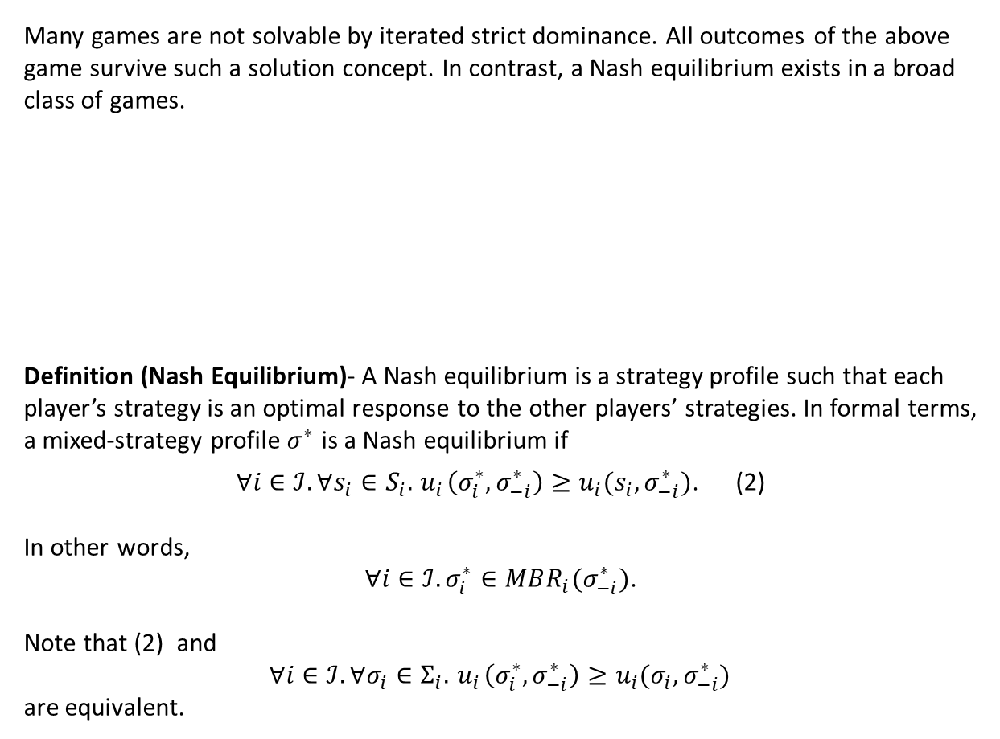
Nash Equilibrium
Many games are not solvable by iterated strict dominance. All outcomes of the above game survive such a solution concept. In contrast, a Nash equilibrium exists in a broad class of games.
Definition (Nash Equilibrium)- A Nash equilibrium is a strategy profile such that each player’s strategy is an optimal response to the other players’ strategies. In formal terms, a mixed-strategy profile $σ^{∗}$ is a Nash equilibrium if
$∀i∈ℐ. ∀s_{i}∈S_{i}. { u}_{i}\left(σ_{i}^{∗},σ_{−i}^{∗}\right)≥u_{i}(s_{i},σ_{−i}^{∗})$. (2)
In other words,
$∀i∈ℐ. σ_{i}^{∗}∈MBR_{i}(σ_{−i}^{∗})$.
Note that (2) and
$∀i∈ℐ. ∀σ_{i}∈Σ_{i}. { u}_{i}\left(σ_{i}^{∗},σ_{−i}^{∗}\right)≥u_{i}(σ_{i},σ_{−i}^{∗})$
are equivalent.
L
R
U
5 , 5
4 , 4
D
4 , 4
5 , 5

Slide 14
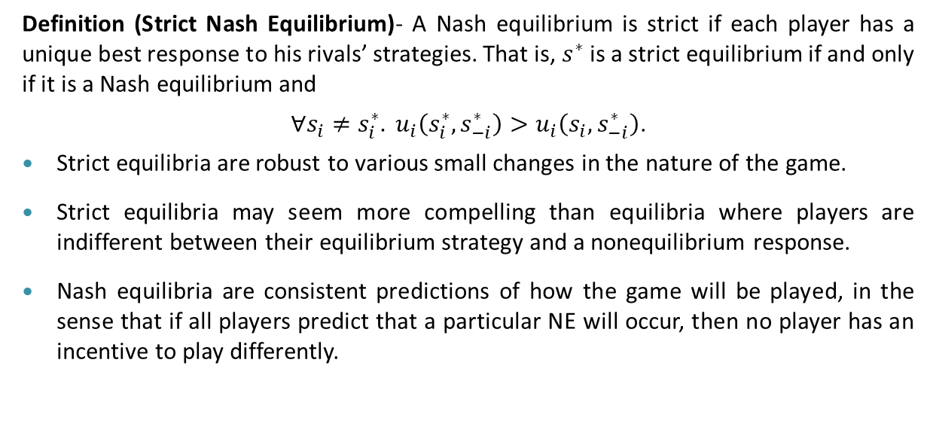
Nash Equilibrium
Definition (Strict Nash Equilibrium)- A Nash equilibrium is strict if each player has a unique best response to his rivals’ strategies. That is, $s^{∗}$ is a strict equilibrium if and only if it is a Nash equilibrium and
$∀s_{i}≠s_{i}^{∗}. u_{i}\left(s_{i}^{∗},s_{−i}^{∗}\right)>u_{i}\left(s_{i},s_{−i}^{∗}\right)$.
Strict equilibria are robust to various small changes in the nature of the game.
Strict equilibria may seem more compelling than equilibria where players are indifferent between their equilibrium strategy and a nonequilibrium response.
Nash equilibria are consistent predictions of how the game will be played, in the sense that if all players predict that a particular NE will occur, then no player has an incentive to play differently.

Slide 15
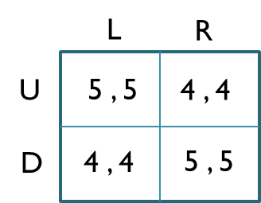






Nash Equilibrium
Consider the following game.
All strategy profiles survive iterated strict dominance and are also rationalizable. Now, consider the strategy profile (U,R). It is rationalizable because it leads to consistent beliefs.
  Player 1 plays U.
  U is a best response by player 1 if she believes that player 2 is choosing L.
  Player 2’s choice of L would be rationalized by his belief that player 1 plays U.
Similarly,
  Player 2 plays R.
  R is a best response by player 2 if he believes that player 1 is choosing D.
  Player 1’s choice of D would be rationalized by her belief that player 2 plays R.
After this game is played in this way, each player will realize ex post that her/his beliefs about her/his opponent were incorrect, and further, each will regret her/his own choice in the light of what she/he learned about her/his opponent’s strategy.
Now, establish the set of players’ beliefs justifying the game outcome (U,L). What is the result?
$$ℛ\left(U\right)$$
$$ℛ\left(𝒞\left(L\right)\right)$$
$$ℛ\left(𝒞\left(ℛ\left(U\right)\right)\right)$$
$$𝒞\left(R\right)$$
$$𝒞\left(ℛ\left(D\right)\right)$$
$$𝒞\left(ℛ\left(𝒞\left(R\right)\right)\right)$$

Slide 16
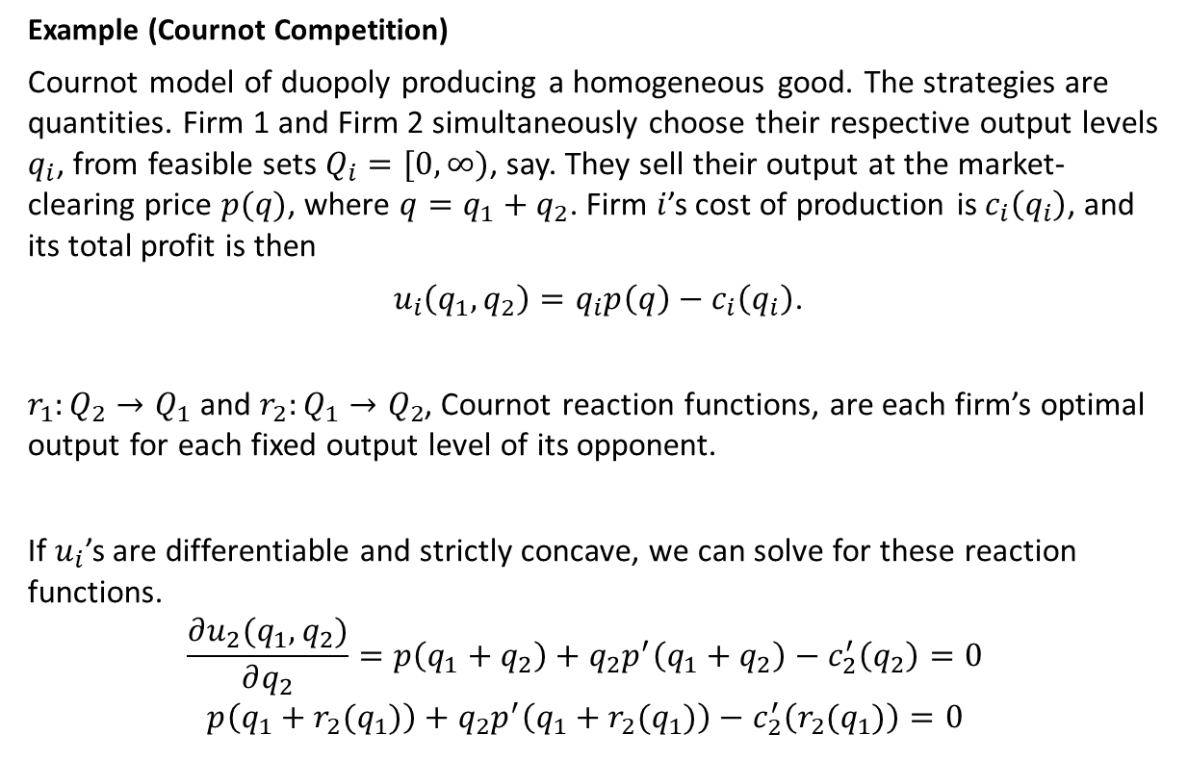
Nash Equilibrium
Example (Cournot Competition)
Cournot model of duopoly producing a homogeneous good. The strategies are quantities. Firm 1 and Firm 2 simultaneously choose their respective output levels $q_{i}$, from feasible sets $Q_{i}=[0,∞)$, say. They sell their output at the market-clearing price $p(q)$, where $q=q_{1}+q_{2}$. Firm $i$’s cost of production is $c_{i}\left(q_{i}\right)$, and its total profit is then
$u_{i}\left(q_{1},q_{2}\right)=q_{i}p\left(q\right)−c_{i}\left(q_{i}\right)$.
$r_{1}:Q_{2}→Q_{1}$ and $r_{2}:Q_{1}→Q_{2}$, Cournot reaction functions, are each firm’s optimal output for each fixed output level of its opponent.
If $u_{i}$’s are differentiable and strictly concave, we can solve for these reaction functions.
$$\frac{∂u_{2}(q_{1},q_{2})}{∂q_{2}}=p\left(q_{1}+q_{2}\right)+q_{2}p^{′}\left(q_{1}+q_{2}\right)−c_{2}^{′}\left(q_{2}\right)=0$$
$$p\left(q_{1}+r_{2}(q_{1})\right)+q_{2}p^{′}\left(q_{1}+r_{2}(q_{1})\right)−c_{2}^{′}\left(r_{2}(q_{1})\right)=0$$

Slide 17
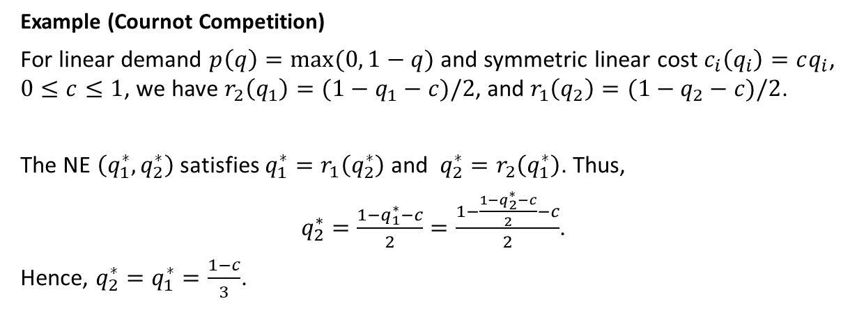
Nash Equilibrium
Example (Cournot Competition)
For linear demand $p\left(q\right)=max⁡(0, 1−q)$ and symmetric linear cost $c_{i}\left(q_{i}\right)=cq_{i}$, $0≤c≤1$, we have $r_{2}\left(q_{1}\right)=(1−q_{1}−c)/2$, and $r_{1}\left(q_{2}\right)=(1−q_{2}−c)/2$.
The NE $\left(q_{1}^{∗},q_{2}^{∗}\right)$ satisfies $q_{1}^{∗}=r_{1}\left(q_{2}^{∗}\right)$ and $q_{2}^{∗}=r_{2}\left(q_{1}^{∗}\right)$. Thus,
$q_{2}^{∗}=\frac{1−q_{1}^{∗}−c}{2}=\frac{1−\frac{1−q_{2}^{∗}−c}{2}−c}{2}$.
Hence, $q_{2}^{∗}=q_{1}^{∗}=\frac{1−c}{3}$.

Slide 18
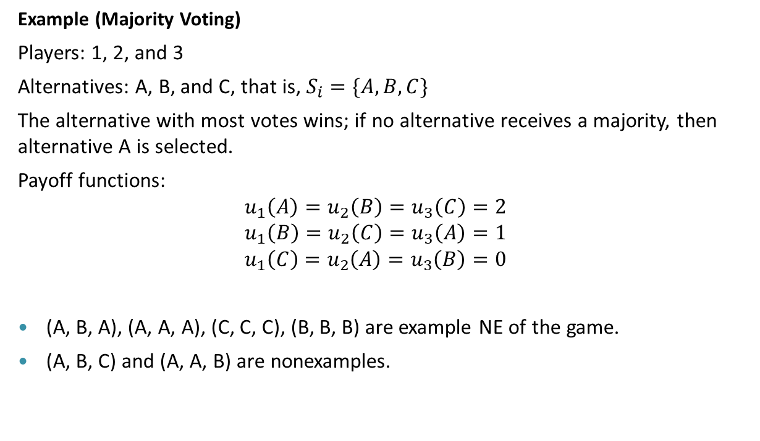
Nash Equilibrium
Example (Majority Voting)
Players: 1, 2, and 3
Alternatives: A, B, and C, that is, $S_{i}=\{A, B, C\}$
The alternative with most votes wins; if no alternative receives a majority, then alternative A is selected.
Payoff functions:
$$u_{1}\left(A\right)=u_{2}\left(B\right)=u_{3}\left(C\right)=2$$
$$u_{1}\left(B\right)=u_{2}\left(C\right)=u_{3}\left(A\right)=1$$
$$u_{1}\left(C\right)=u_{2}\left(A\right)=u_{3}\left(B\right)=0$$
(A, B, A), (A, A, A), (C, C, C), (B, B, B) are example NE of the game.
(A, B, C) and (A, A, B) are nonexamples.

Slide 19
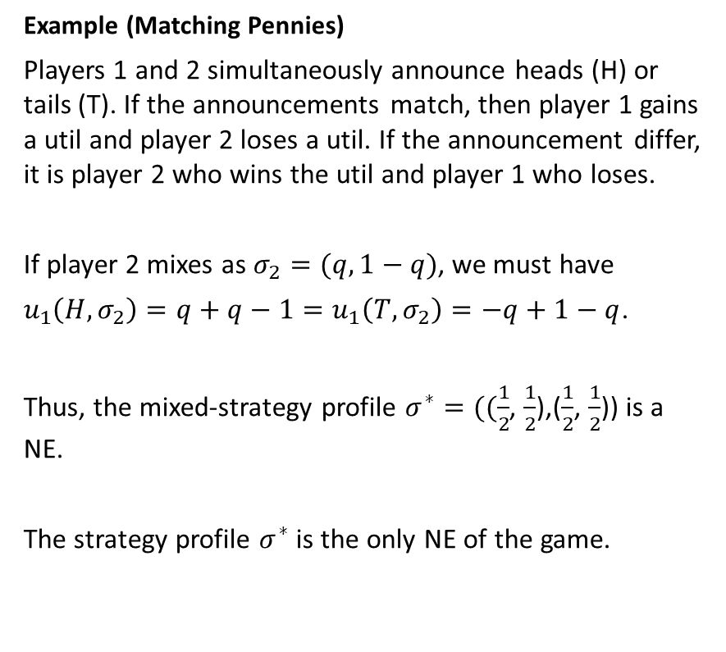
Nash Equilibrium
Example (Matching Pennies)
Players 1 and 2 simultaneously announce heads (H) or tails (T). If the announcements match, then player 1 gains a util and player 2 loses a util. If the announcement differ, it is player 2 who wins the util and player 1 who loses.
If player 2 mixes as $σ_{2}=(q, 1−q)$, we must have
$u_{1}\left(H, σ_{2}\right)=q+q−1=u_{1}\left(T, σ_{2}\right)=−q+1−q$.
Thus, the mixed-strategy profile $σ^{∗}=((\frac{1}{2}$, $\frac{1}{2}$),($\frac{1}{2}$, $\frac{1}{2}$)) is a NE.
The strategy profile $σ^{∗}$ is the only NE of the game.
H
T
H
1 , -1
-1 , 1
T
-1 , 1
1 , -1

Slide 20
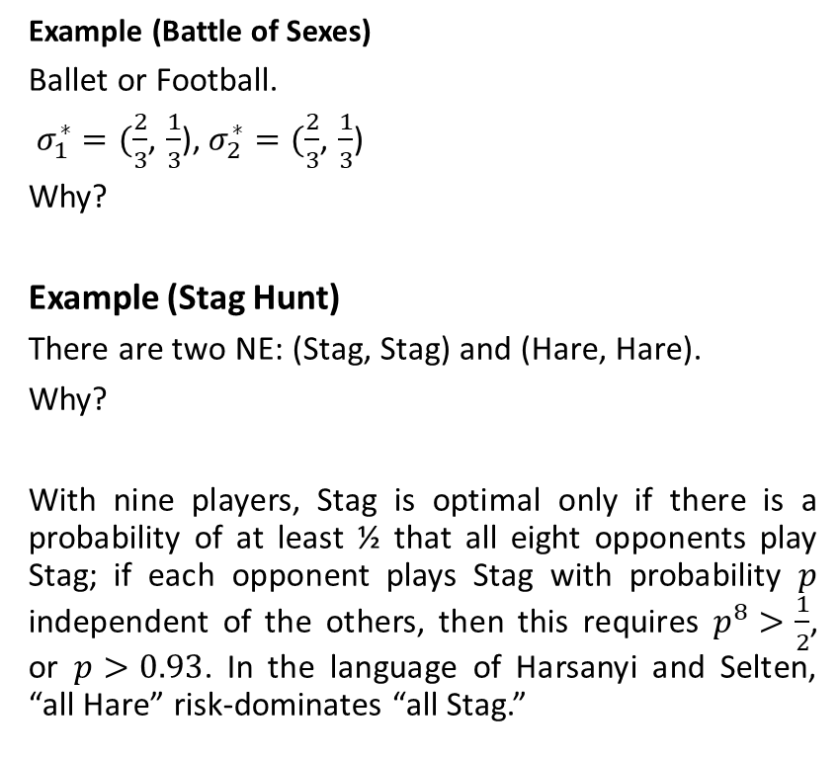
Nash Equilibrium
B
F
Example (Battle of Sexes)
Ballet or Football.
$σ_{1}^{∗}=(\frac{2}{3}$, $\frac{1}{3}$), $σ_{2}^{∗}=(\frac{2}{3}$, $\frac{1}{3}$)
Why?
Example (Stag Hunt)
There are two NE: (Stag, Stag) and (Hare, Hare).
Why?
With nine players, Stag is optimal only if there is a probability of at least ½ that all eight opponents play Stag; if each opponent plays Stag with probability $p$ independent of the others, then this requires $p^{8}>\frac{1}{2}$, or $p>0.93$. In the language of Harsanyi and Selten, “all Hare” risk-dominates “all Stag.”
F
0 , 0
2 , 1
B
1 , 2
0 , 0
Stag
Hare
Stag
2 , 2
0 , 1
Hare
1 , 0
1 , 1

Slide 21
Any Question?

